Slide 1


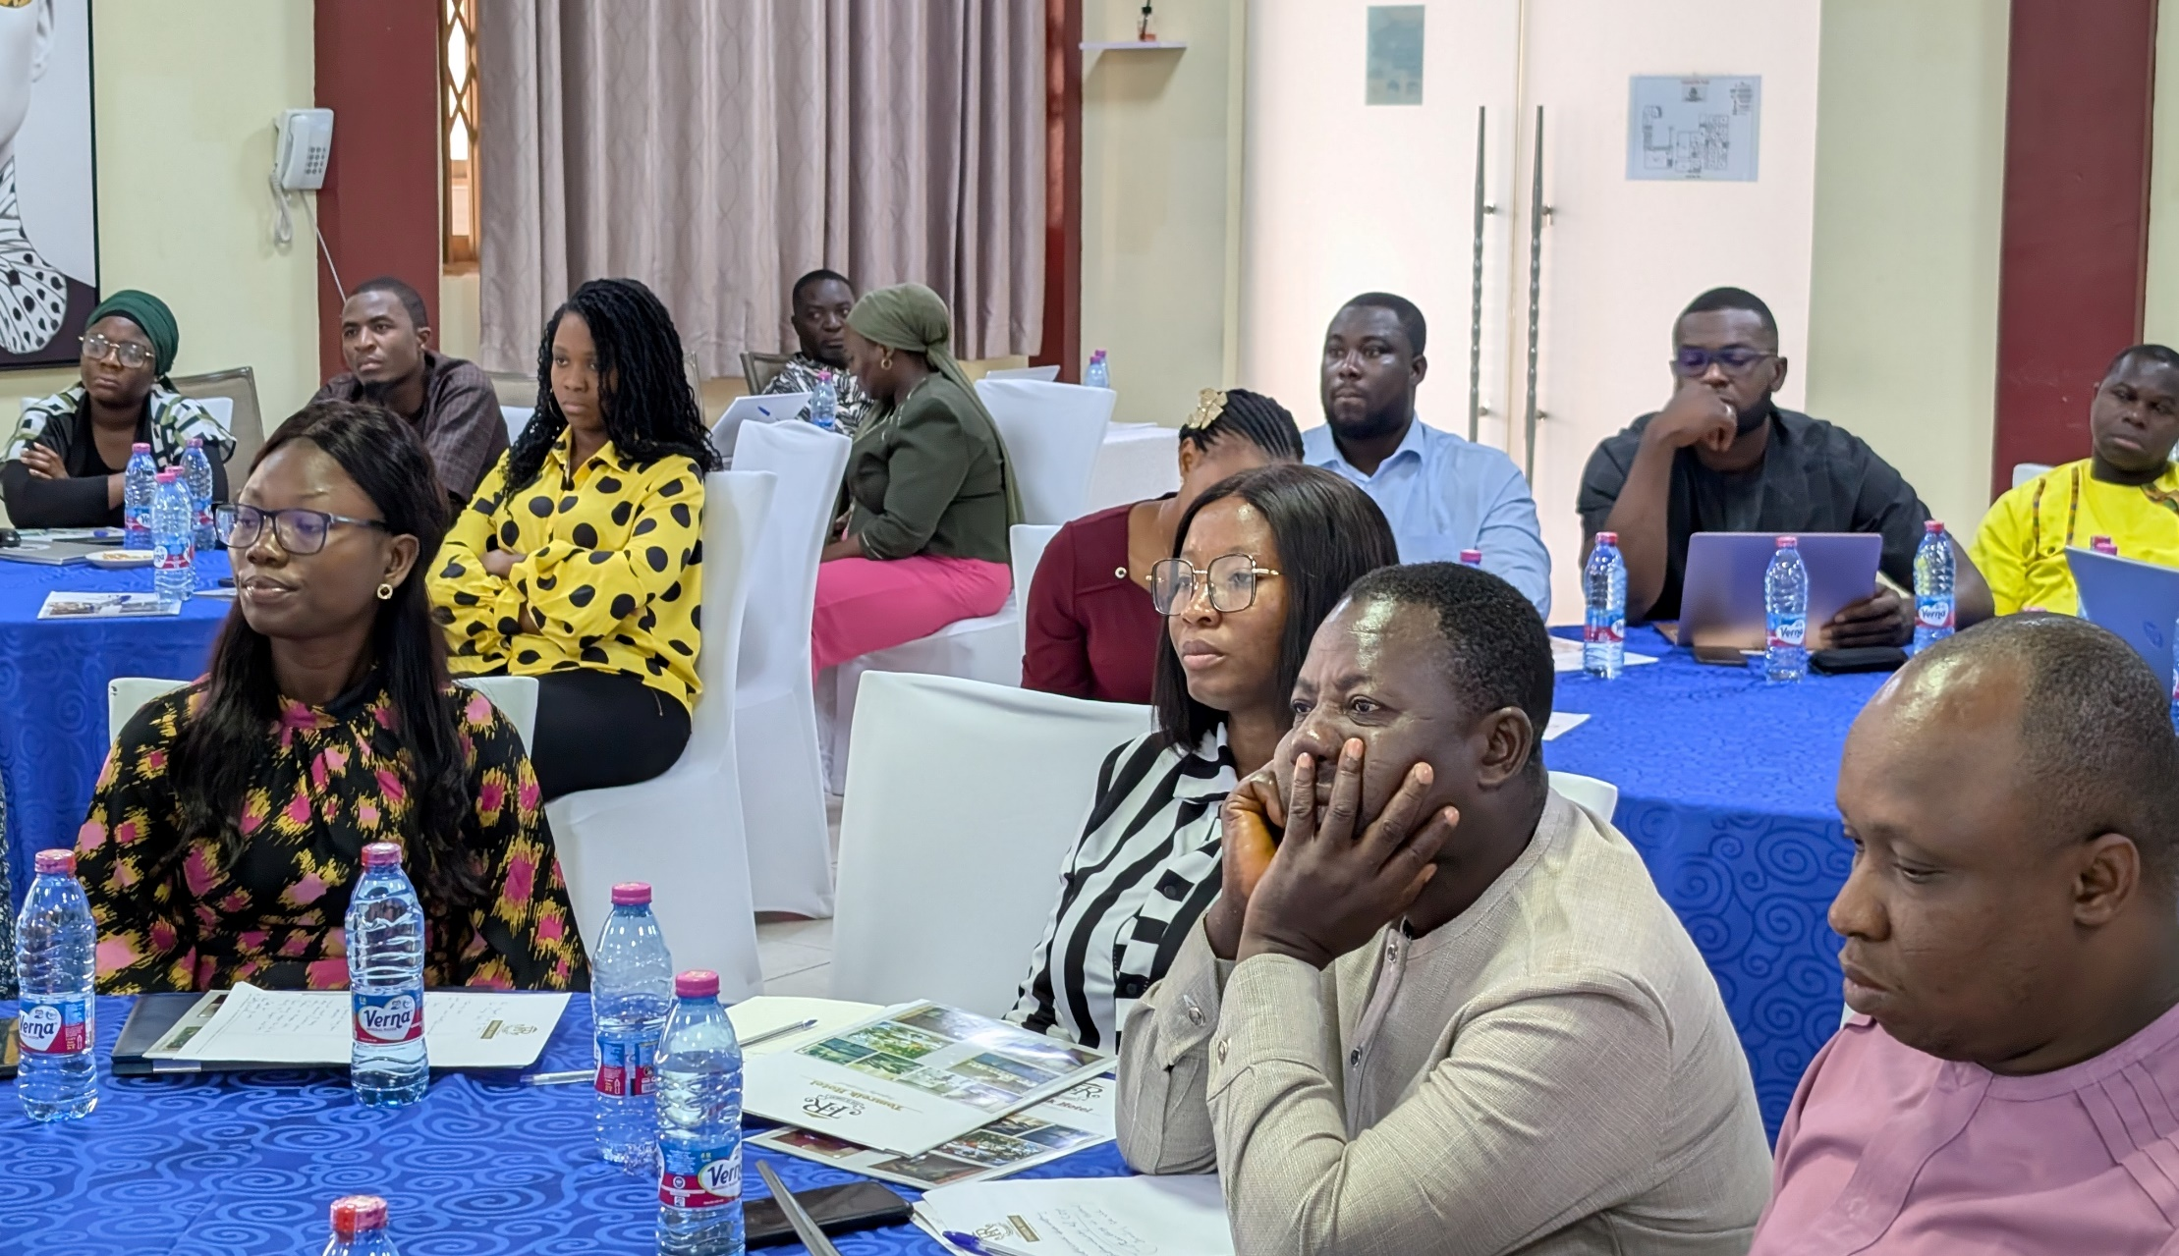
THE IMPACT OF USAID FUNDING CUTS ON GHANAIAN CSOs
June 2025

Slide 2


Presentation Outline
Introduction
Background Data of Respondents (CSOs)
Key Findings
Key Recommendations
Key Reflections

Slide 3

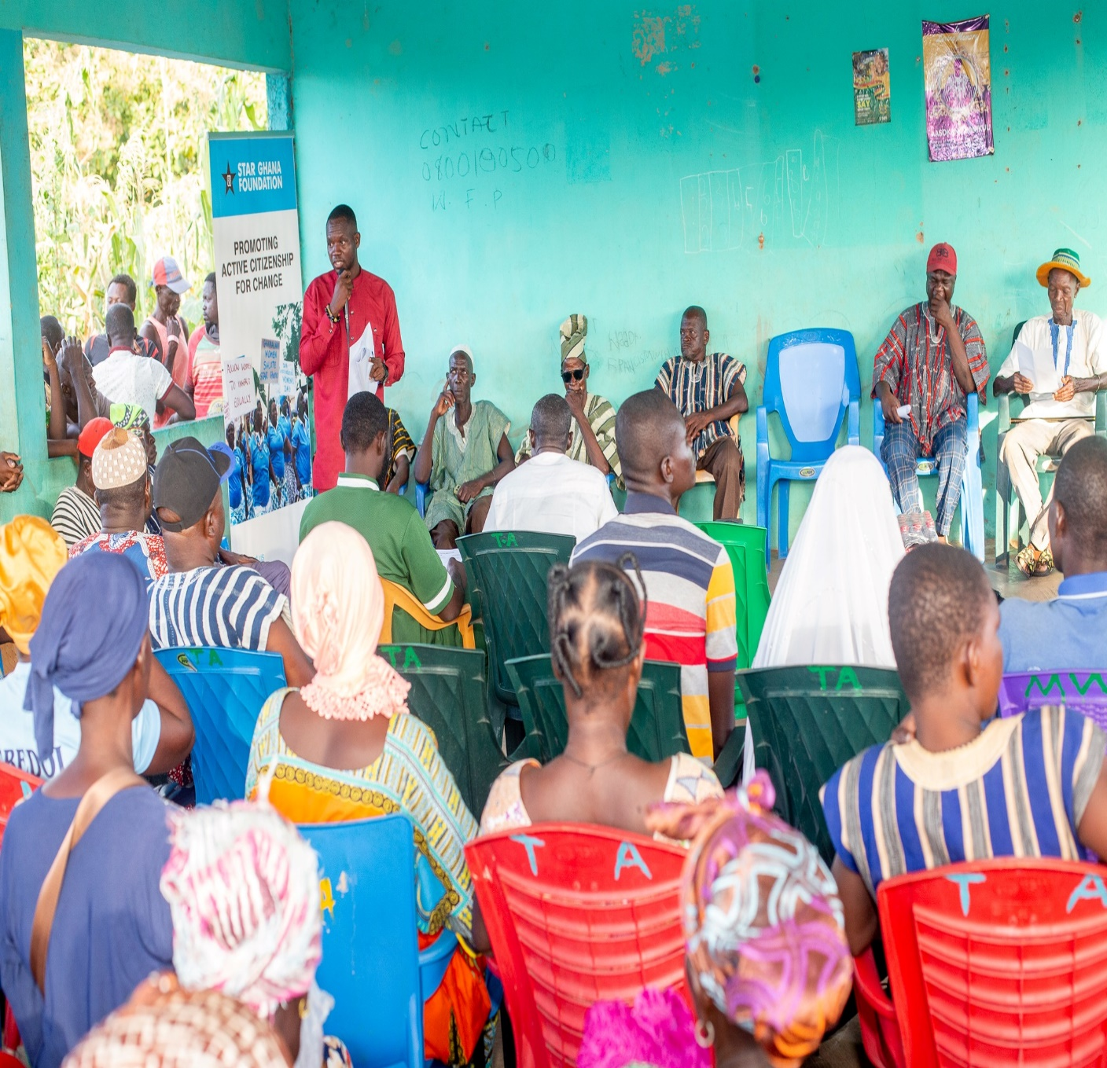
Introduction
Objective of study: To assess the impact of USAID funding cuts on CSOs operating in Ghana and generate key reflections for broader stakeholder engagements
  Survey period: 25th March – 9th May 2025
  Data collection mode: Google Forms
  Sample: 113 CSOs (Convenience sampling)
  Eligibility: All CSOs operating in Ghana

Slide 4
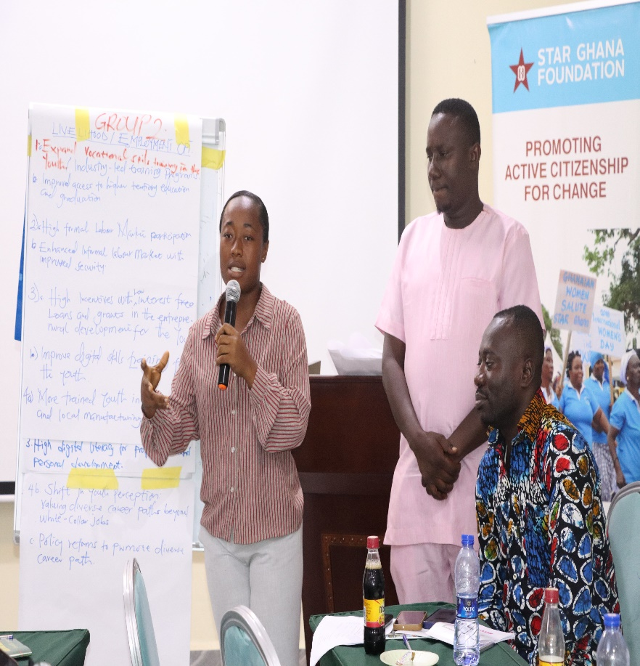
Background Data of Sampled CSOs
More than half (59%) of the CSOs interviewed were operating at the regional/national level
Majority of the CSOs (45%) were located in the Northen zone
58% of the CSOs had a staff strength between 1 and 10
Majority of the CSOs (58%) were in existence for 10 or more years

Slide 5

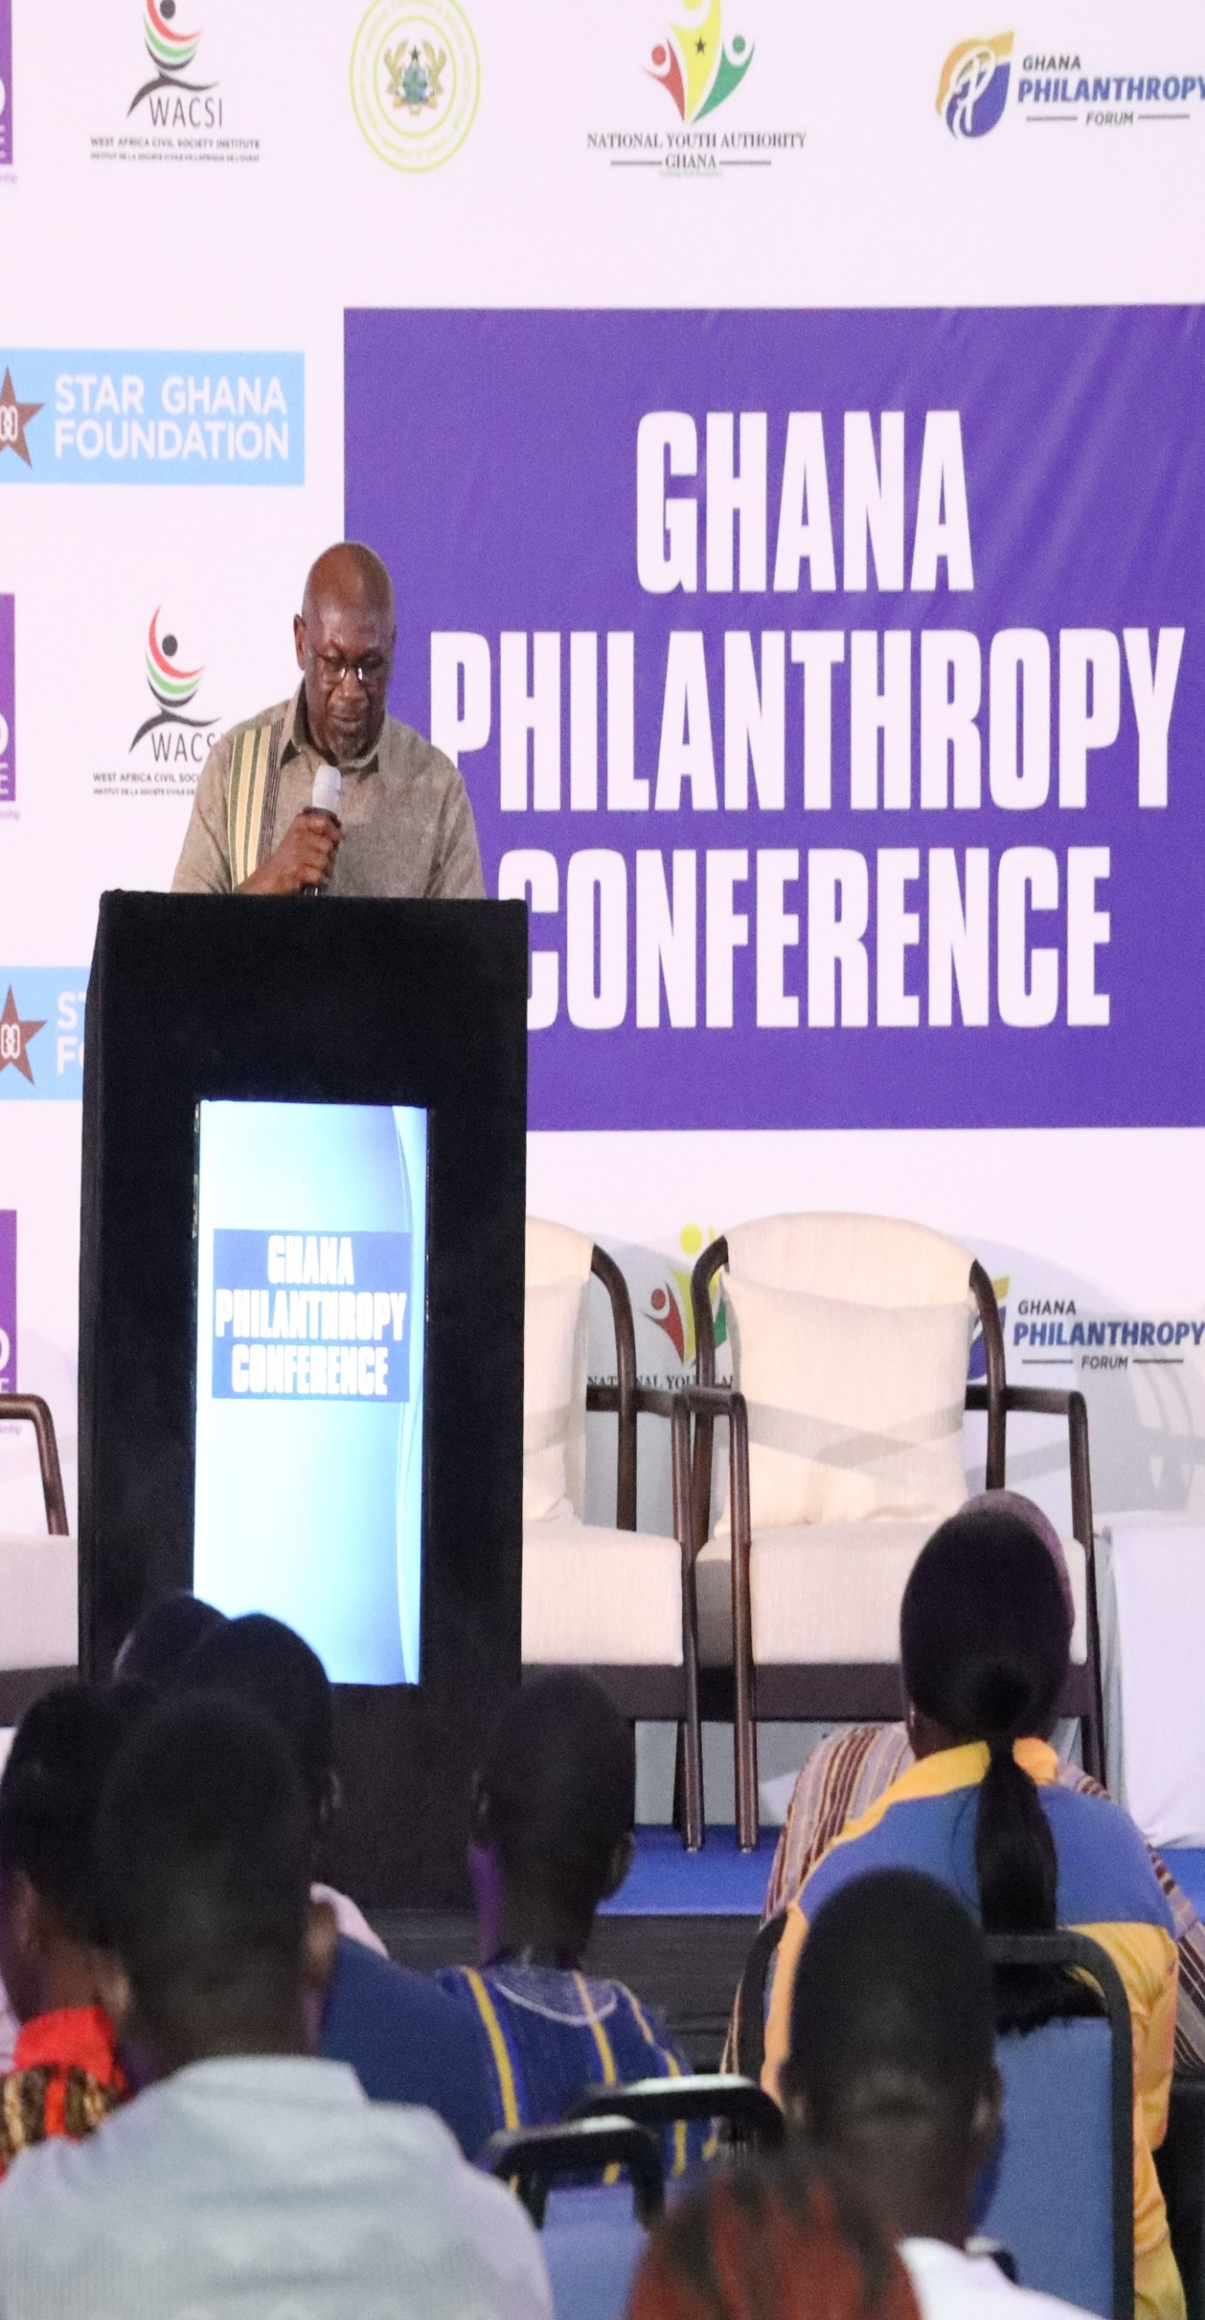
Key Findings
Impacted by USAID
More than half (58%) of the respondents were affected by the USAID funding cut
1 out every 5 CSOs (20%) interviewed were directly affected
Almost 4 out of every 10 CSOs were affected both directly
(the organization itself)and indirectly(Partners supported by the
sampled organization)
Majority (51%) of the CSOs affected were in the Northern zone
The top 2 thematic areas affected are Health (74%) and Education (72%)

Slide 6

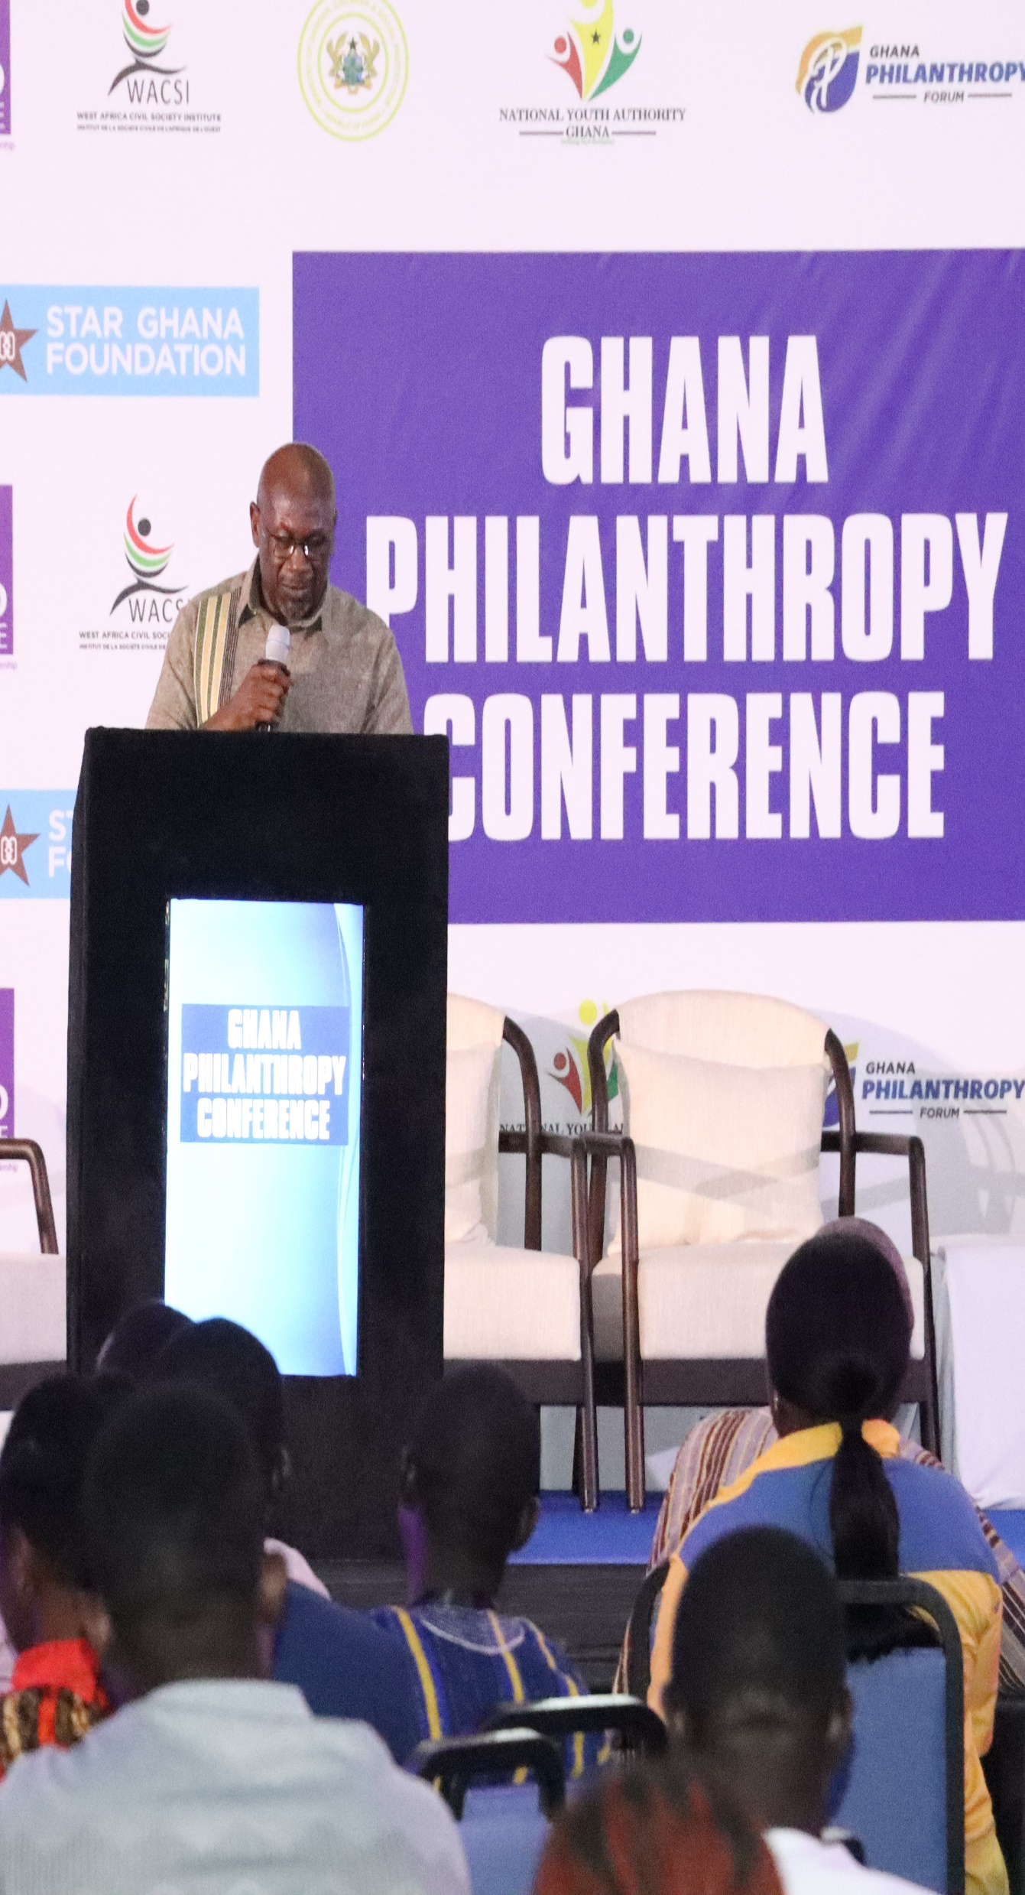

Key Findings
Alternative Funding
91% of the CSOs affected are yet to secure alternative funding after the USAID cut
Almost half (46%) of the CSOs yet to secure alternative funding are unlikely to secure funding in the 6 months – 12 months
Effect on staff strength
320 staff across the affected organisations were laid off
More than half (58%) of the CSOs affected by the cut, reduced their staff strength by 30 – 50%

Slide 7



Key Findings
Dependency on USAID
More than half (57%) of the CSOs affected had a maximum annual budget $100K in 2024
72% of the affected CSOs had a maximum of 50% of their budget funded by USAID in 2024
Advocacy related to USAID cut
Only 4 out of every 10 organizations affected have engaged in any form of advocacy related to the USAID cut
Most of the engagements (72%) have happened at the regional/national level

Slide 8



Key Recommendations from CSOs
Strengthen Local Resource Mobilization: Domestic fundraising
Build Strategic Partnerships
Advocate for Policy Support
Promote Social Enterprises
Capacity Building for Financial Resilience

Slide 9

Key Reflections
CSOs impacted by USAID cut
The effect was felt more strongly in the northern part of Ghana and around the health and education thematic areas.
CSOs should be deliberate in engaging the Government to provide funding for the continuation of these initiatives
Effect on staff strength
The USAID cut resulted in CSOs taking up some devasting and inevitable measures.
This affected the livelihoods of 320 staff who were laid off

Slide 10
Key Reflections
Alternative Funding to USAID cut
Half of the CSOs who are yet to secure alternative funding are unlikely to do that even in the next one year.
A call for capacity support and awareness around alternative funding opportunities (including local fund raising).
Dependency on USAID
The study highlights high level of dependency of CSOs on USAID funding
This provides an opportunity for CSOs to think widely beyond foreign aid and potentially ignite conversations around local philanthropy, social enterprise and other funding initiatives.

Slide 11
Key Reflections
Advocacy related to USAID cut
In such circumstances, advocacy around the implications and possible redress is a very critical way forward.
However, less than half of the affected organisations are yet to engage in any form of advocacy.
These limited engagements curtail critical thinking amongst stakeholders on CSOs dependency on foreign aid.

Slide 12

GROUP
REFLECTIONS!!
www.reallygreatsite.com

Slide 13

THANK YOU!
www.reallygreatsite.com

